Slide 1
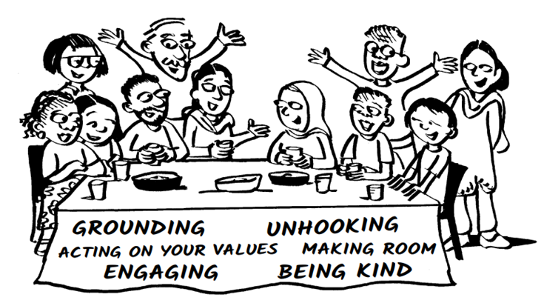
Who am I?
What’s my topic?

Slide 2
Smiling Therapy Positive effects on Mental Health

Slide 3
Why is mental health important?
Mental health is important because it’s a vital part of your life and impacts your thoughts, behaviors , emotions
The World Heath Organization (WHO) reports a sharp rise in the number of people experiencing mental illness in recent years, with the COVID-19 pandemic increasing mental health problems throughout the world.
For students, it is more important than ever to address the mental health issues to stay mentally healthy and keep up with your educational and personal goals.

Slide 4
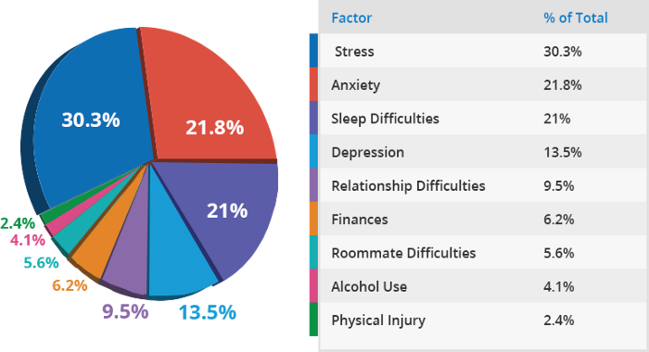
Factors Disrupting Academic Performance

Slide 5
Smiling Therapy
Smile therapy is a way to enhance, the power of a smile ,to influence physical and mental health.
It’s an infusion of good energy. But more than that, smiling is good for the heart.

Slide 6
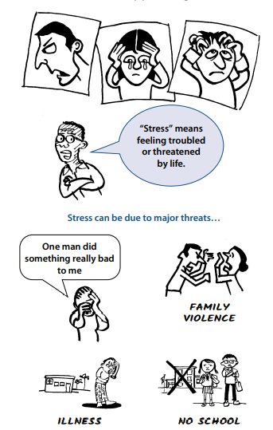
Factors affecting mental health
Loneliness
Grief and loss
Bullying
Sleeping problems
Academics
Childhood trauma
Physical injuries and
Illnesses

Slide 7
Benefits of Smiling
Smiling Helps You Live Longer
Smiling Relieves Stress
Smiling Elevates Mood
Smiling Boosts the Immune System
Smiling Helps You Stay Positive
Smiling May Lower Blood Pressure

Slide 8
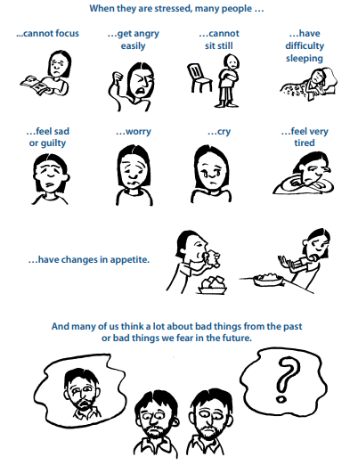

How to ?
Fake It Till You Make It
Smile Whether You Mean It Or Not
Smiling Helps On A Day-To-Day Basis

Slide 9
References
www.northernhealthcare.org
www.verywellmind.com
www.nbcnews.com
www.sclhealth.org

Slide 10


Thank You

